Slide 1
Section 1.1
Introduction to
Function Notations
© Copyright all rights reserved to Homework depot: www.BCMath.ca

Slide 2
I) What is a Function Notation?
is a symbol for representing a function and it replaces the ‘y-variable in an equation
‘f’ is a function of ‘x’
You can use other letters to represent a function→ g, h, t,
Rule: Whatever ‘x’ becomes in the brackets (left), you replace that with the same value for ‘x’ on the right side of the equation
Ex: Given the equation for the function, evaluate the following:

Slide 3
Practice: Given the function, evaluate each of the following:

Slide 4
II) How to READ function notations
The value inside the brackets for ‘x’, is the input number (x-coordinate) and
The value of the function is the Output number (y-coordinate)
The function h(x) will
have a point at (4,22)
Ex: Given the graph of y=f(x), which statement is correct:
8
6
The input number is “5”
4
According to the graph F(x), when the x-coordinate
is ‘5’, the y-coordinate is ‘4’
2
The correct statement is
1
2
3
4
5
6
7
8
9

Slide 5
Evaluate the following using the graphs:
Solid Dot; Value
at this point
Solid Dot; Value
at this point
8
8
6
6
Hollow Dot
No value
4
4
2
2
Hollow Dot
No value
0
1
2
3
4
5
6
7
8
9
1
2
3
4
5
6
7
8
9

Slide 6
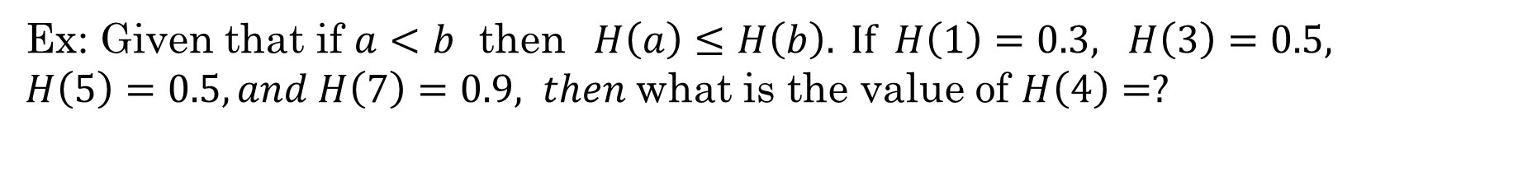
Ex: Given that H(x) is a linear function, find the slope and y-intercept with the given information
Ex: Given that if $a<b$ then$H\left(a\right)≤H\left(b\right). If H\left(1\right)=0.3, H\left(3\right)=0.5,$
$H\left(5\right)=0.5,and H\left(7\right)=0.9, then$what is the value of $H\left(4\right)=?$
Suppose:
and we are given that:

Slide 7
Ex: Given that H(x) is a linear function, find the slope and y-intercept with the given information
h(x) is a linear function, so it is the form of
Find the equation with the coordinates of points given:

Slide 8
Suppose:
and we are given that:

Slide 9
III) Composite Functions: Input Value as a function
When the input value is a function, replace every “x” in the equation with the inserted function, make sure to simplify
Suppose find the following

Slide 10
Practice: Given each function evaluate the following

Slide 11
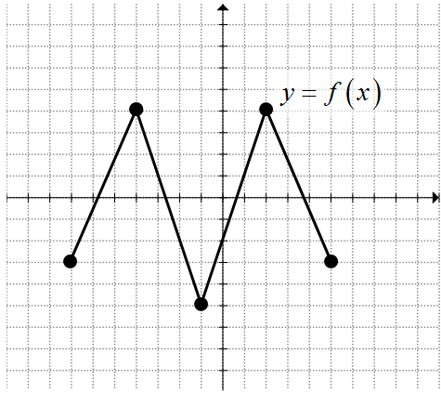
Ex: Given the graph of f(x), evaluate the following

Slide 12
IV) Piece Wise Function:
A function that has more than one equation and it depends on the value of the domain:
This function has two parts, if “x” is less than or equal to 8, then you use the equation above
If “x” is greater than 8, then you use the equation below
Ex: Using the equation above, evaluate the following:

Slide 13

Ex: Write the piece-wise function of$y=f(x)$ below:
First step: Split the domain into sections where you see a different function
Second step: Determine the equation of each function
Write the piece wise with two rows b/c there are two separate equations:
Linear function slope of 2 and y-intercept of 2
Horizontal
line at y=2

Slide 14
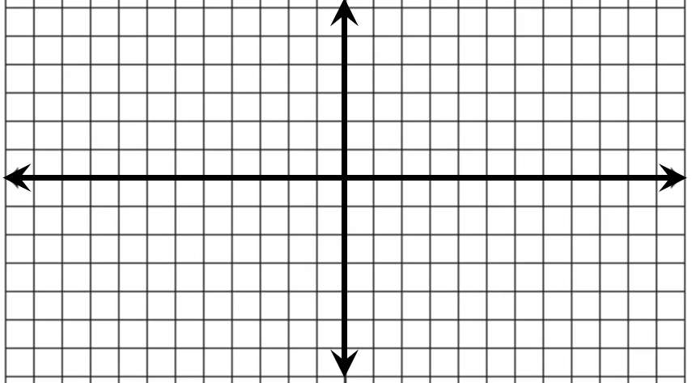
Ex: Given the following points, write a piece-wise function for the function that connects all the points:
Get the equation for each line segment:
Now indicate the domain for each segment
Now write the piece wise function:

Slide 15
2007b amc12

